Slide 1
Azure Software Development Kit (SDK) for .NET
Author: Luis Coco Enríquez

Slide 2
Agenda
Topic
What is Azure SDK for .NET?.
Key Azure Services for .NET developers
How to set up your environment.
API Reference.

Slide 3
Agenda
Topic
Code examples with guidance for the Azure SDK for .NET.
Additional code examples for the Azure SDK for .NET.
GitHub repositories.
C# code samples with Azure SDK for .NET.

Slide 4
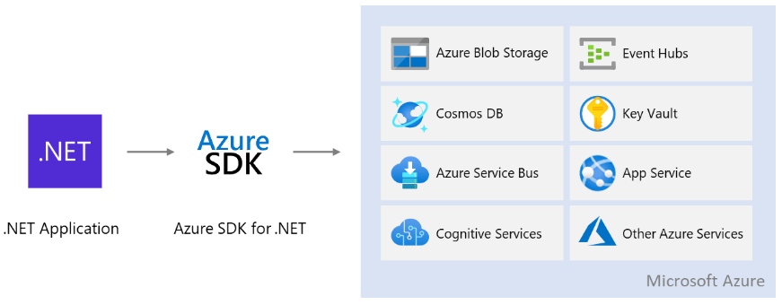
What is Azure SDK for .NET?
The
Azure for .NET developers | Microsoft Learn

Slide 5


Key Azure Services for .NET developers

Slide 6
How to setup your environment
Follow these steps to install and run the Azure SDK for .NET:
1. Create an Azure free account. See video: How to Create a Free Azure Account in Few Minutes
2. Install Azure CLI:
3. Login in Azure account with the command: az login
4. See your Azure account details with the command: az account show
5.
How to install Azure CLI

Slide 7
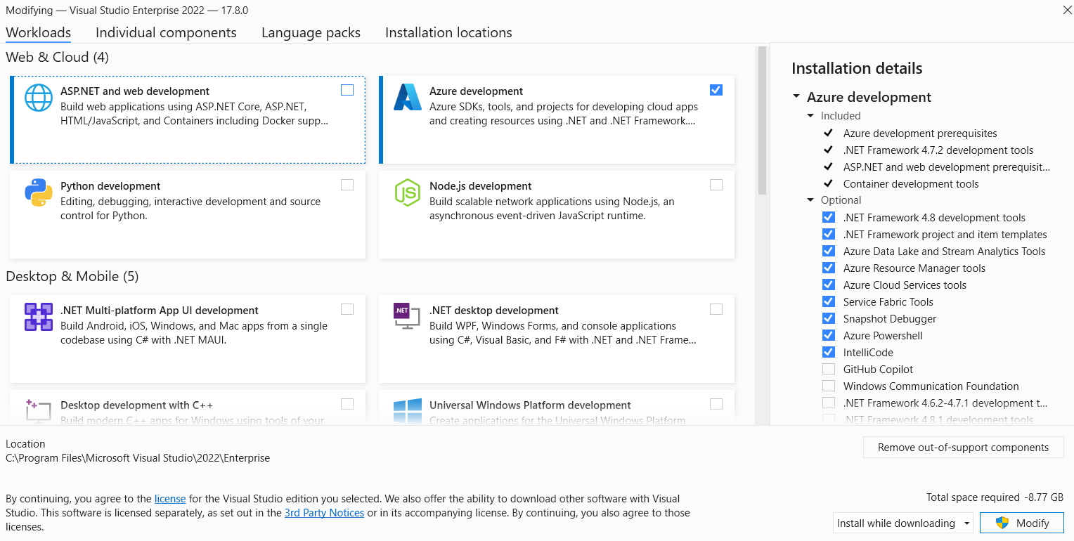
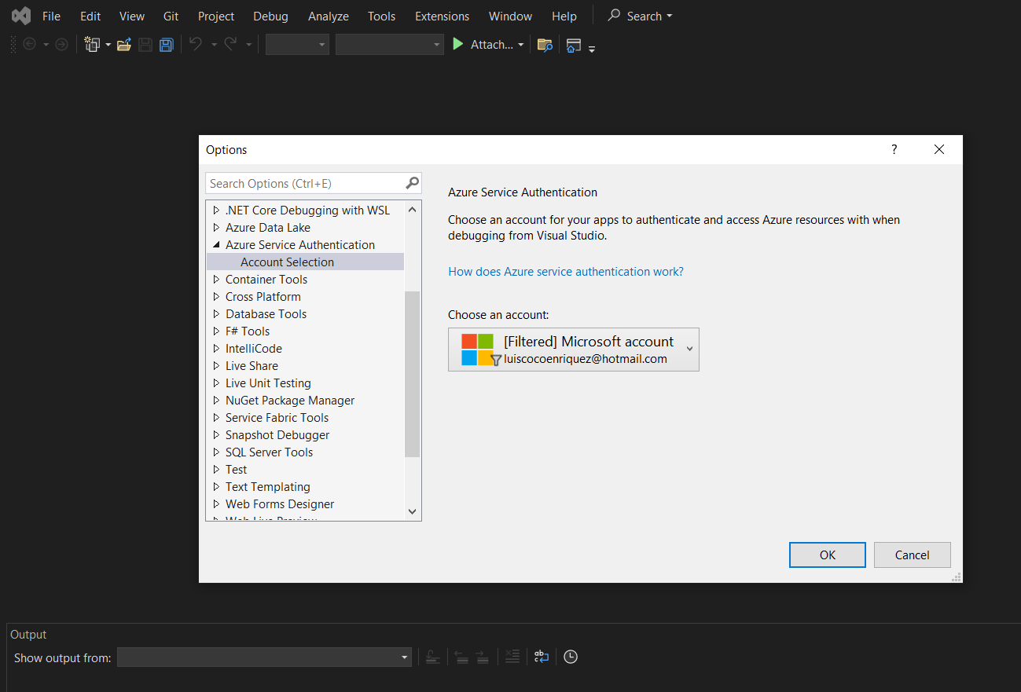
Azure for Visual Studio 2022
https://visualstudio.microsoft.com/vs/community/
https://learn.microsoft.com/en-us/dotnet/azure/configure-visual-studio

Slide 8
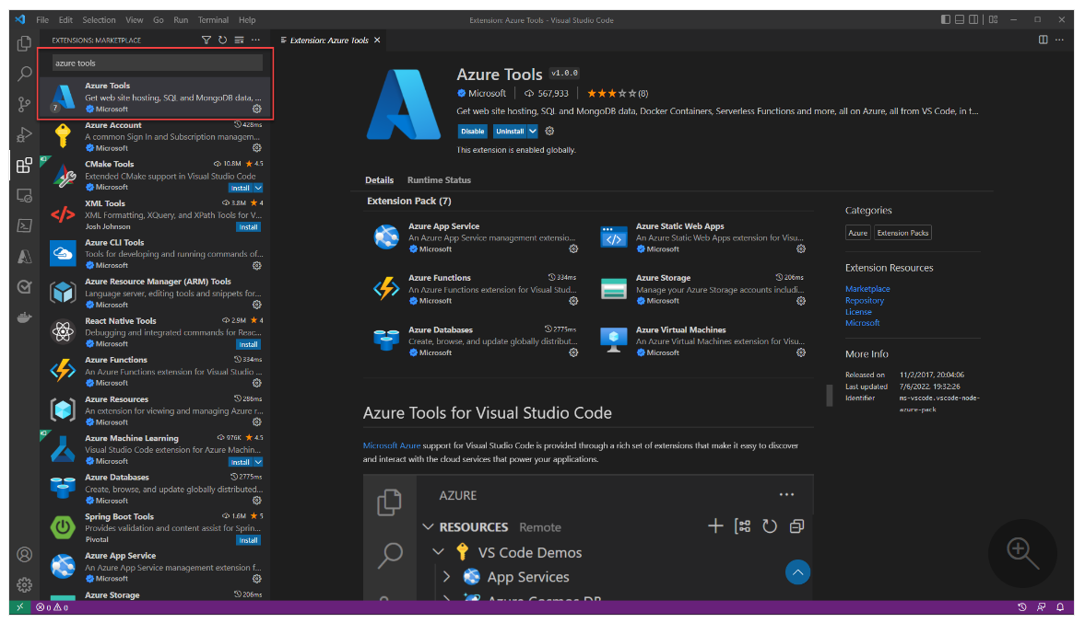
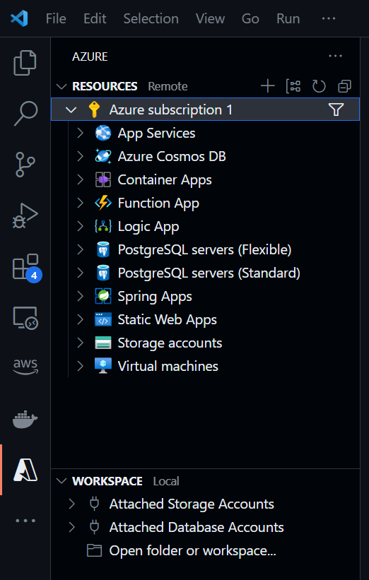
Azure extensions for Visual Studio Code
https://learn.microsoft.com/en-us/dotnet/azure/configure-vs-code

Slide 9
Azure SDK for .NET package index
https://learn.microsoft.com/en-us/dotnet/azure/sdk/packages
Azure SDK releases
https://azure.github.io/azure-sdk/releases/latest/index.html#net

Slide 10
GitHub repositories
The Developer guide for the Azure SDK for .NET
https://github.com/Azure/azure-sdk-for-net

Slide 11
DefaultAzureCredential() for Azure SDK for .NET
1. Login in Azure typing the command (previously install Azure CLI): az login
2. Create a C# console application with the command: dotnet new console --framework net8.0
3. Load the library “Azure.Identity” running the command: dotnet add package Azure.Identity --version 1.10.4
4. Load the library “Azure.Storage.Blobs” running the command:
dotnet add package Azure.Storage.Blobs --version 12.19.1
5. Input the C# application source code:
using Azure.Identity;
using Azure.Storage.Blobs;
var uri = new Uri("https://mynewstorageaccount1974.blob.core.windows.net/newblob/blob.txt");
var cred = new DefaultAzureCredential();
var client = new UploadAsyncBlobClient(uri, cred);
await client. ("blob.txt");
StorageAccountName
BlobConatinerName
BlobName

Slide 12
C# code samples with Azure SDK for .NET
Sample 1:
Sample 2:
Sample 3:
Sample 4:
Sample 5:
Sample 6:
Sample 7:
Sample 8:
Sample 9:
Sample 10:

Slide 13
C# code samples with Azure SDK for .NET
Sample 1: create a Blob container inside an Azure Storage account
using Azure.Storage.Blobs;
string connectionString = “<AzureStorageAccountConnectionString>";
string containerName = "data1";
BlobServiceClient blobServiceClient = new BlobServiceClient(connectionString);
Console.WriteLine("Creating the container");
await blobServiceClient.CreateBlobContainerAsync(containerName);

Slide 14
C# code samples with Azure SDK for .NET
Sample 2: List blobs containers in an Azure Storage account
using Azure.Storage.Blobs;
using Azure.Storage.Blobs.Models;
string connectionString = "<AzureStorageAccountConnectionString>";
string containerName = "data";
BlobContainerClient blobContainerClient = new BlobContainerClient(connectionString, containerName);
await foreach(BlobItem blobItem in blobContainerClient.GetBlobsAsync())
{
Console.WriteLine("The Blob Name is {0}",blobItem.Name);
Console.WriteLine("The Blob Size is {0}", blobItem.Properties.ContentLength);
}

Slide 15
C# code samples with Azure SDK for .NET
Sample 3: Upload a file to a blob container
using Azure.Storage.Blobs;
using Azure.Storage.Blobs.Models;
string connectionString = “<AzureStorageAccountConnectionString>";
string containerName = "scripts";
string blobName = "script.sql";
string filePath = "C:\\tmp1\\script.sql";
BlobContainerClient blobServiceClient = new BlobContainerClient(connectionString, containerName);
BlobClient blobClient=blobServiceClient.GetBlobClient(blobName);
await blobClient.UploadAsync(filePath, true);
Console.WriteLine("Uploaded the blob");

Slide 16
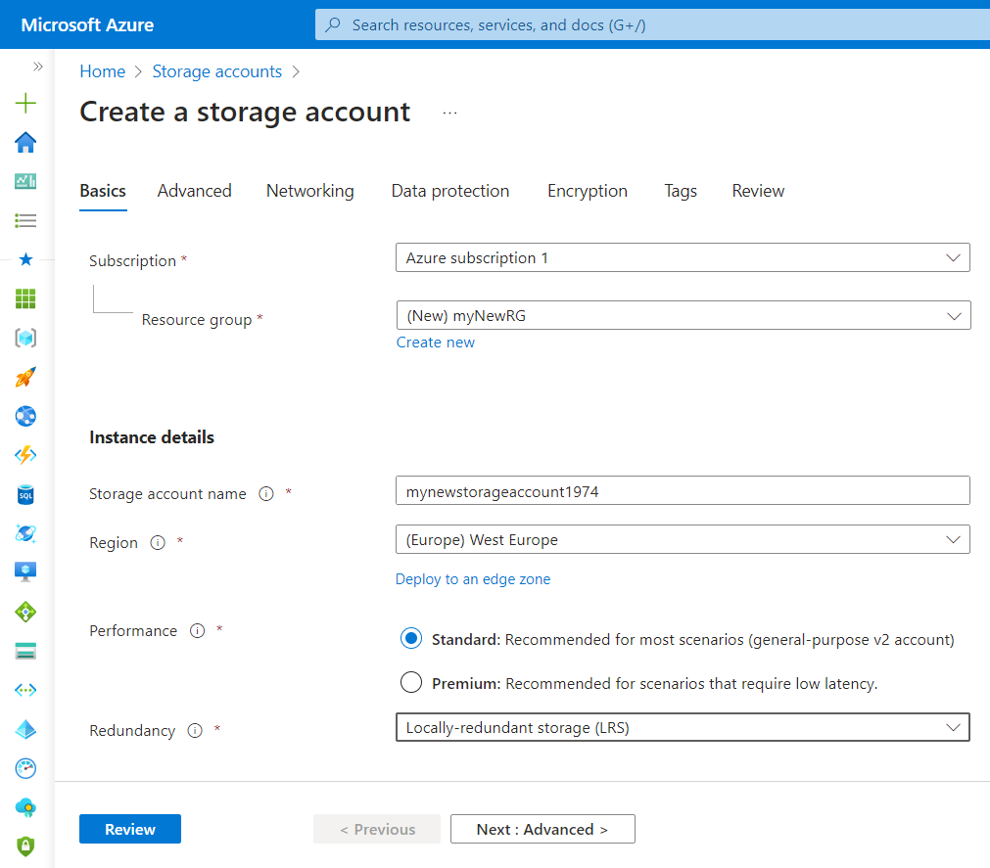
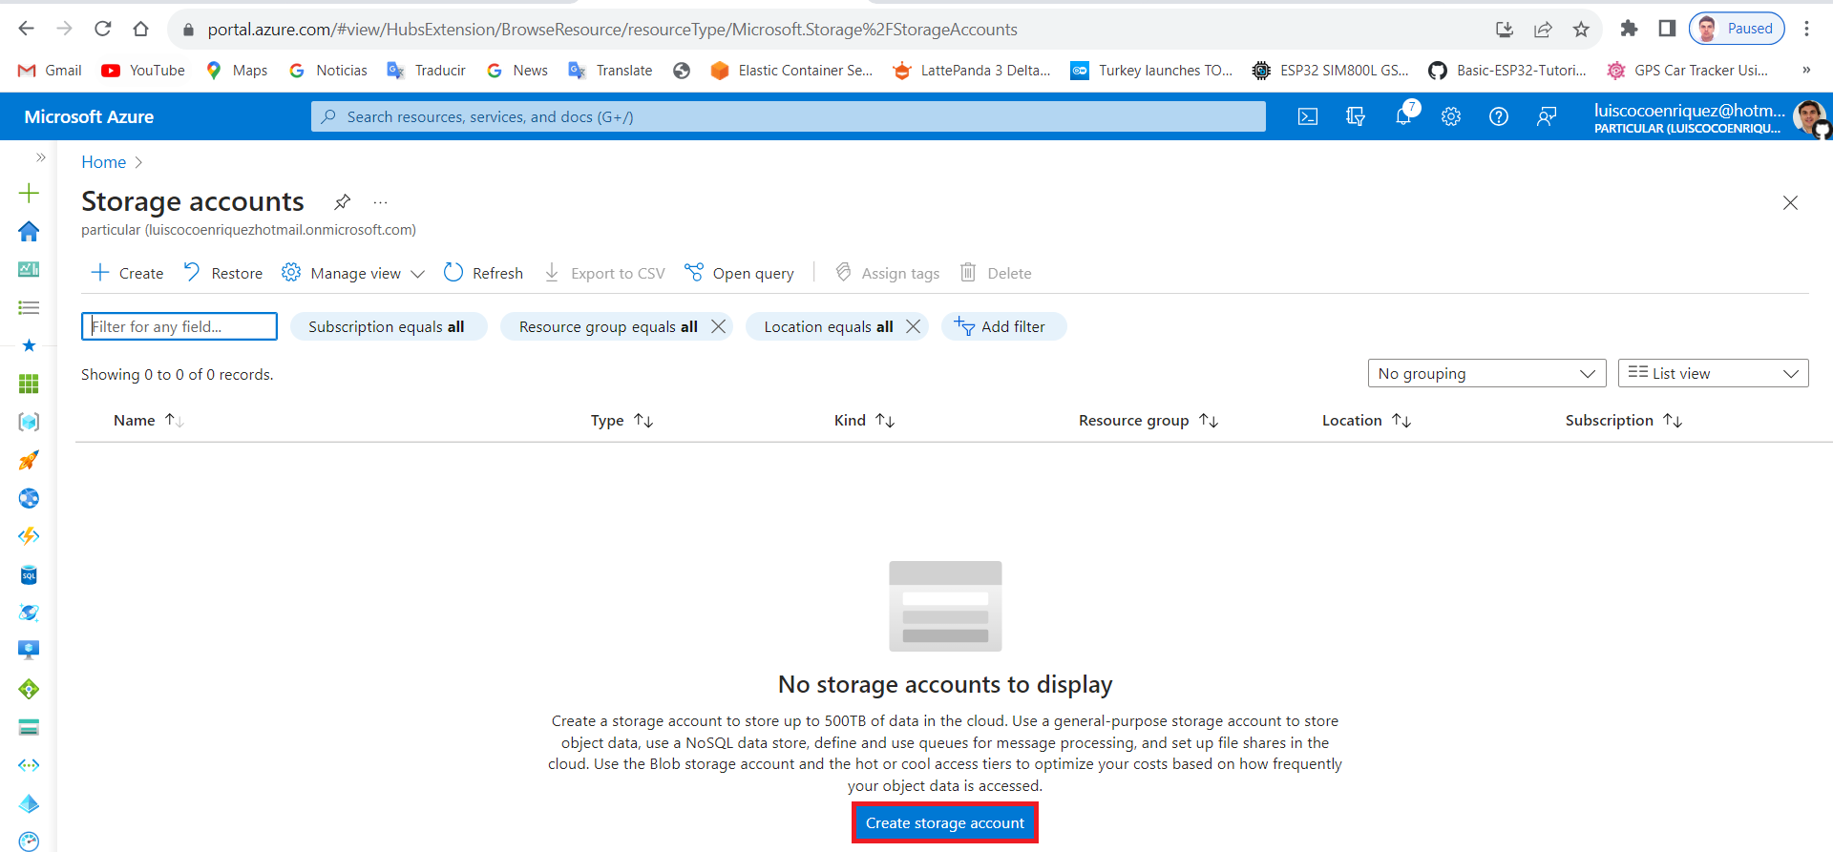
How to create a console application with VSCode
1. Create an Azure Storage account:
Press the “create storage account” button.
Input data: resource group, storage account name, region, redundancy.
https://learn.microsoft.com/en-us/azure/storage/blobs/storage-quickstart-blobs-dotnet

Slide 17
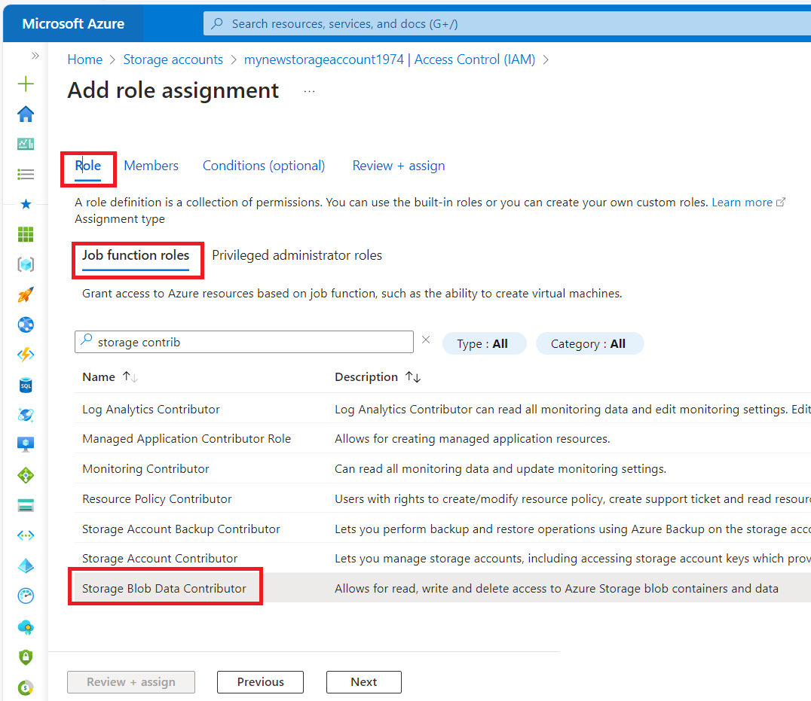
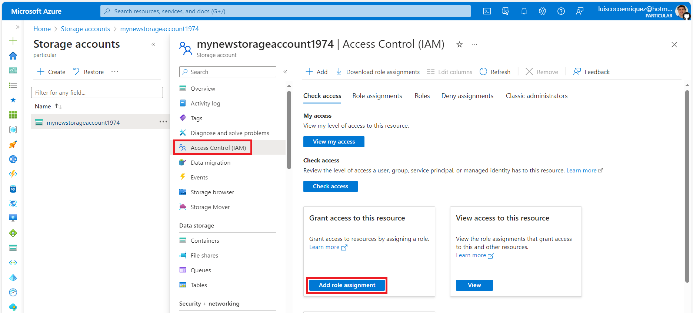
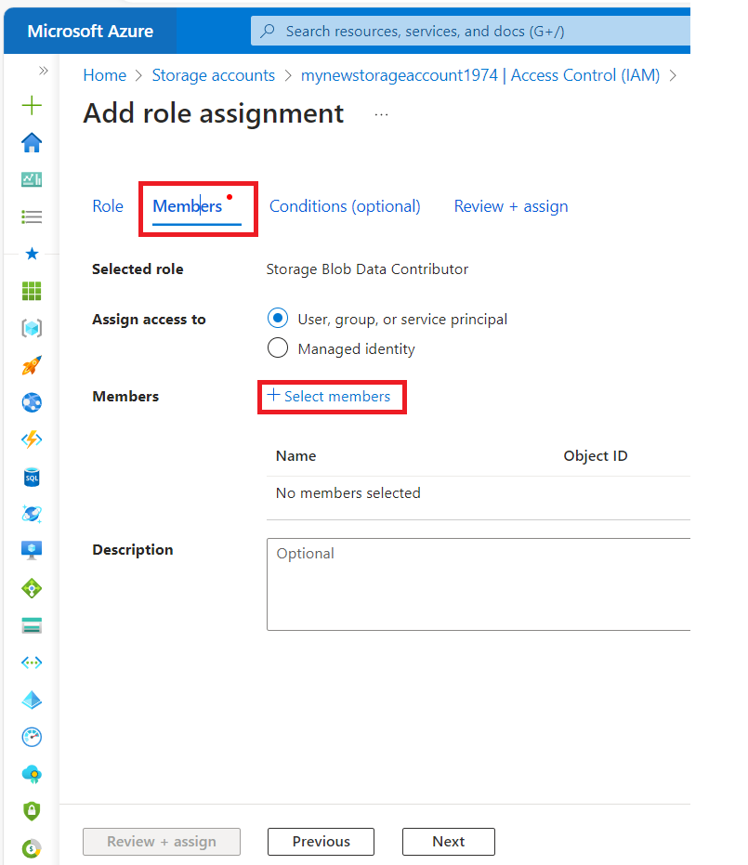
How to create a console application with VSCode
2. Grant permission for creating a Blob container:
Press the Access Control (IAM)
Press the “Add role assignment” button
Add Role: Storage Blob Data Contributor
Add Member: press select member and add the user

Slide 18
How to create a console application with VSCode
3. For installing .NET CLI tools download the .NET 8 SDK: https://dotnet.microsoft.com/en-us/download
4. Open in VSCode a Terminal window and run the command: dotnet new console --framework net8.0
5. Load the Azure SDK for .NET libraries: https://www.nuget.org/packages
dotnet add package Azure.Identity --version 1.10.4
dotnet add package Azure.Storage.Blobs --version 12.19.1
Type the command dotnet restore and see the csproj file.
6. Input the source code in the program.cs file.
7. For building and running the application type the command: dotnet run
https://learn.microsoft.com/en-us/dotnet/core/tools/

Slide 19
How to create a console application with VSCode
using Azure.Storage.Blobs;
using Azure.Storage.Blobs.Models;
using Azure.Identity;
// TODO: Replace <storage-account-name> with your actual storage account name
var blobServiceClient = new BlobServiceClient(
new Uri("https://<storage-account-name>.blob.core.windows.net"),
new DefaultAzureCredential());
//Create a unique name for the container
string containerName = "quickstartblobs" + Guid.NewGuid().ToString();
// Create the container and return a container client object
BlobContainerClient containerClient = await blobServiceClient.CreateBlobContainerAsync(containerName);
// Create a local file in the ./data/ directory for uploading and downloading
string localPath = "data";
Directory.CreateDirectory(localPath);
string fileName = "quickstart" + Guid.NewGuid().ToString() + ".txt";
string localFilePath = Path.Combine(localPath, fileName);
// Write text to the file
await File.WriteAllTextAsync(localFilePath, "Hello, World!");
// Get a reference to a blob
BlobClient blobClient = containerClient.GetBlobClient(fileName);
Console.WriteLine("Uploading to Blob storage as blob:\n\t {0}\n", blobClient.Uri);

Slide 20
How to create a console application with VSCode
// Upload data from the local file
await blobClient.UploadAsync(localFilePath, true);
Console.WriteLine("Listing blobs...");
// List all blobs in the container
await foreach (BlobItem blobItem in containerClient.GetBlobsAsync()) {
Console.WriteLine("\t" + blobItem.Name);
}
// Download the blob to a local file. Append the string "DOWNLOADED" before the .txt extension
string downloadFilePath = localFilePath.Replace(".txt", "DOWNLOADED.txt");
Console.WriteLine("\nDownloading blob to\n\t{0}\n", downloadFilePath);
// Download the blob's contents and save it to a file
await blobClient.DownloadToAsync(downloadFilePath);
// Clean up
Console.Write("Press any key to begin clean up");
Console.ReadLine();
Console.WriteLine("Deleting blob container...");
await containerClient.DeleteAsync();
Console.WriteLine("Deleting the local source and downloaded files...");
File.Delete(localFilePath);
File.Delete(downloadFilePath);
Console.WriteLine("Done");

Slide 21
How to create a console application with VSCode
https://learn.microsoft.com/en-us/azure/storage/common/storage-samples-dotnet
https://github.com/Azure/azure-sdk-for-net/blob/main/sdk/storage/Azure.Storage.Blobs/samples/Sample02_Auth.cs#L27
Authentication
1. Authenticate using a connection string:
using Azure Portal: click Access Keys under Security in the Portal Storage account blade
using Azure CLI with: az storage account show-connection-string --name <account_name> --resource-group <resource_group>
2. Authenticate using a shared key credential SAS (Shared Access Signature)
https://learn.microsoft.com/en-us/azure/storage/blobs/sas-service-create-dotnet
https://github.com/luiscoco/Azure_SDK_Sample10_Create_SAS_for_blob
3. Authenticate with Azure Identity
4. Authenticate using an Active Directory token
5. Anonymously access.

